Slide 1
Stock Market Analysis Capstone Project
By: Anant Bhartia, Aarna Chowdhary, & Sumedh Kundu

Slide 2
We Will be Evaluating the Following for Tesla, Ford, American, United
01
02
05
03
04
Change in stock price over time
Moving average of the various stocks
Predicting future stock prices using an LSTM Model
Correlation between the closing prices of the stocks
How much value do we put at risk when investing in a particular stock

Slide 3
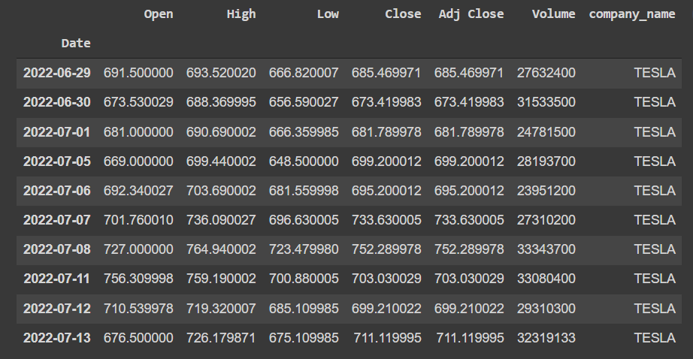
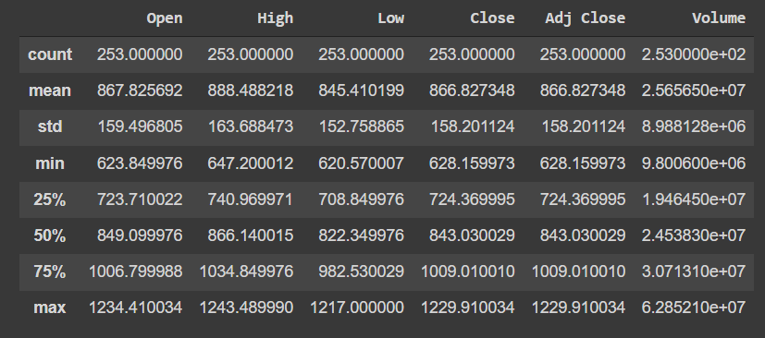
The Data Set
The data set used comprised of data for all companies in the S&P 500 index
Categories found for each company: Date, Open, High, Low Close, Volume, and Name
The pictures to the right show formatted data on the stocks specifically for TESLA

Slide 4
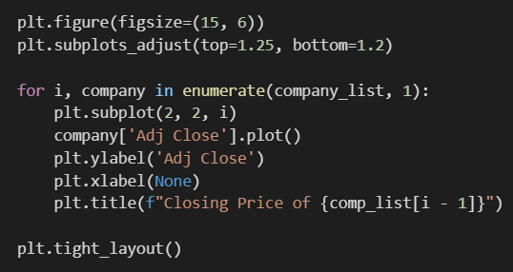
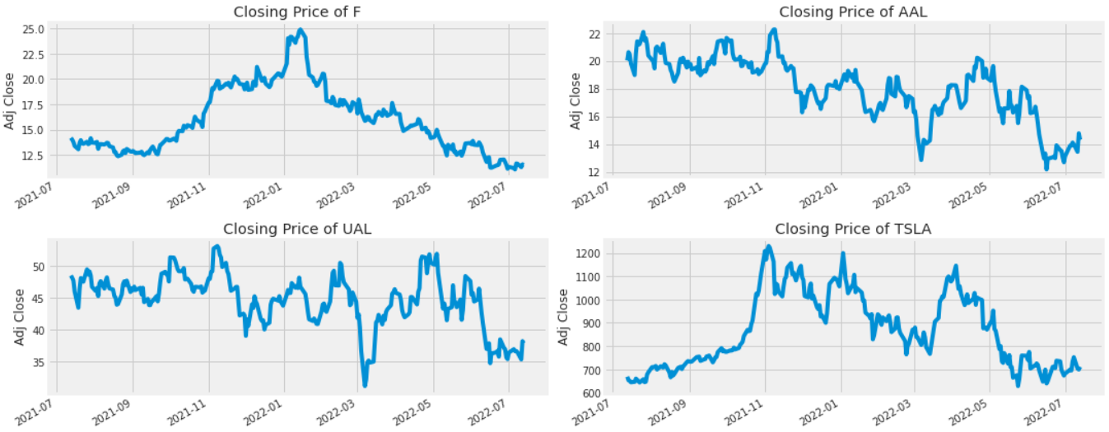
Data Visualization
plt is matplotlib.pyplot
The graphs to the right are of the closing price for the stocks of different companies
Closing price: the price of the last stock traded during a trading period
The x-axis is the date

Slide 5
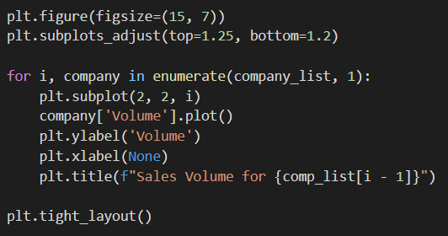
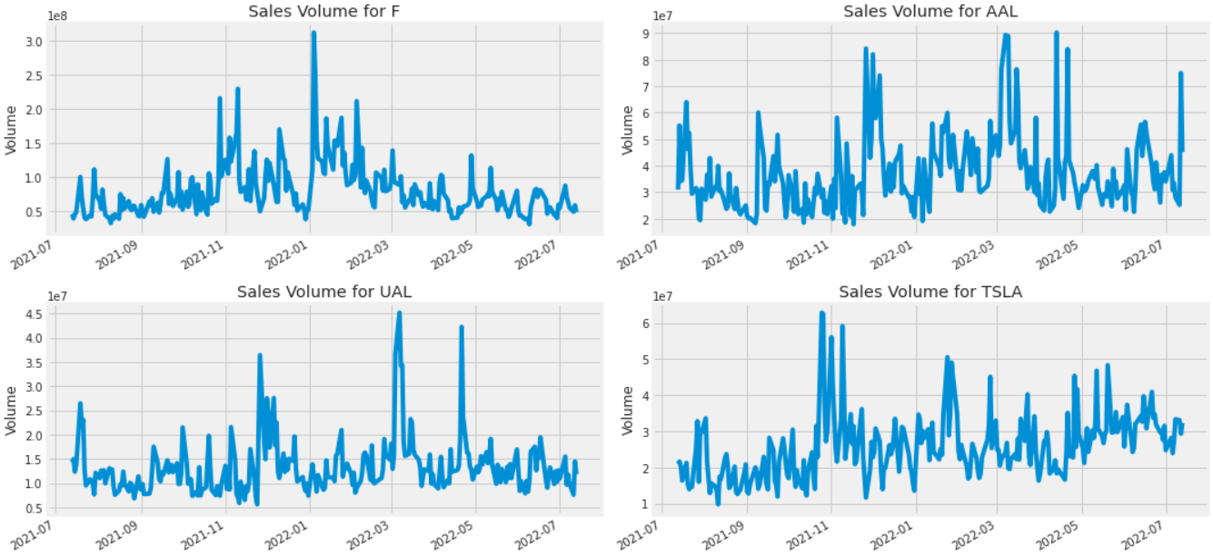
Data Visualization
The graphs to the right are of the total volume of stock for each respective company being traded per day
The x-axis is the date

Slide 6
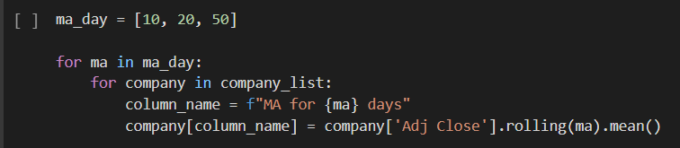
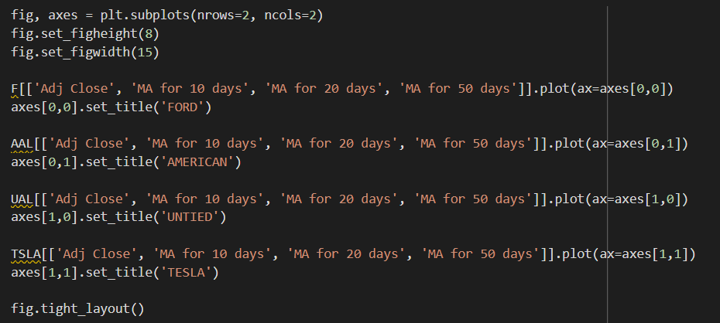
Moving Average
A moving average is comprised of multiple averages of subsets of data. This smooths out data and makes it easier to interpret, especially in cases where data has many short-term fluctuations like in stocks.

Slide 7
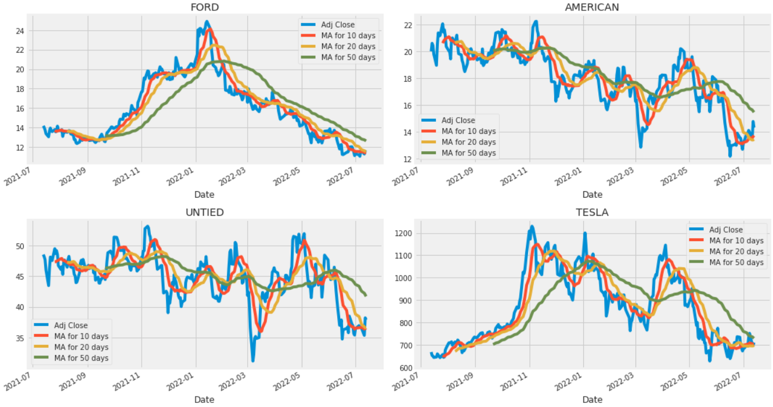
Moving Average

Slide 8
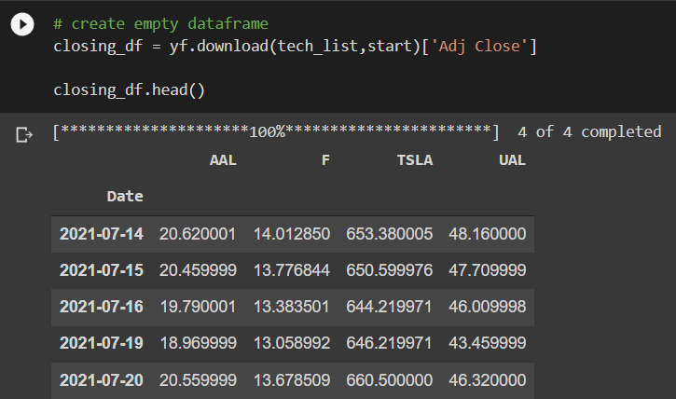
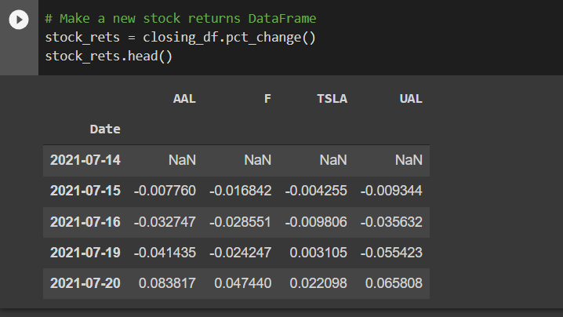
Setup code

Slide 9
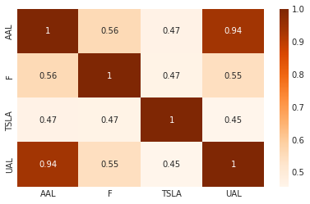
Correlation Coefficient
Strong correlation between airlines (AAL and UAL)
Weak correlation between Tesla and Ford
Driven by variances in variable costs of Tesla and Ford vs similarity of airlines

Slide 10
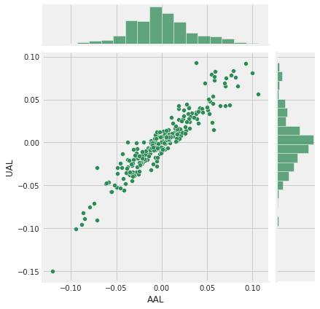
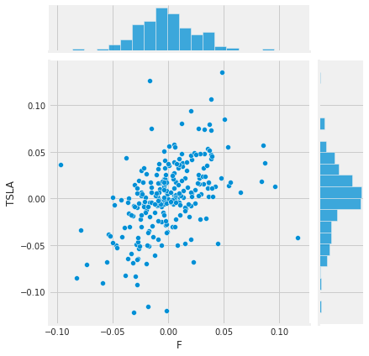
Scatterplot

Slide 11
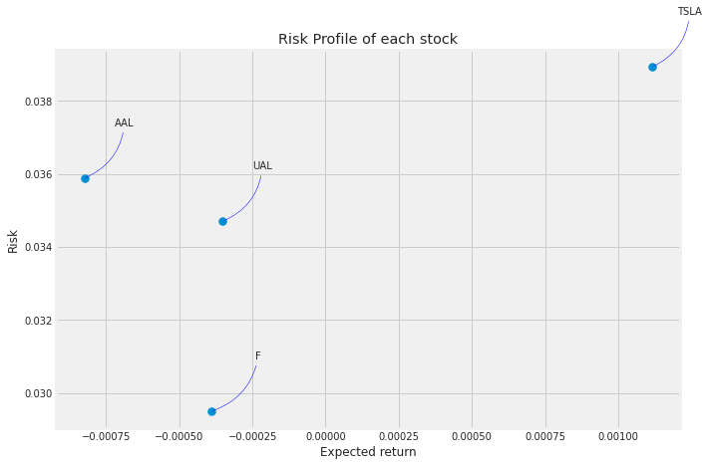
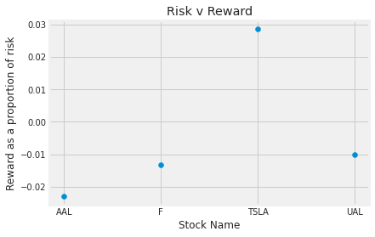
Risk Profile

Slide 12
05
Predicting Stocks Using LSTM

Slide 13
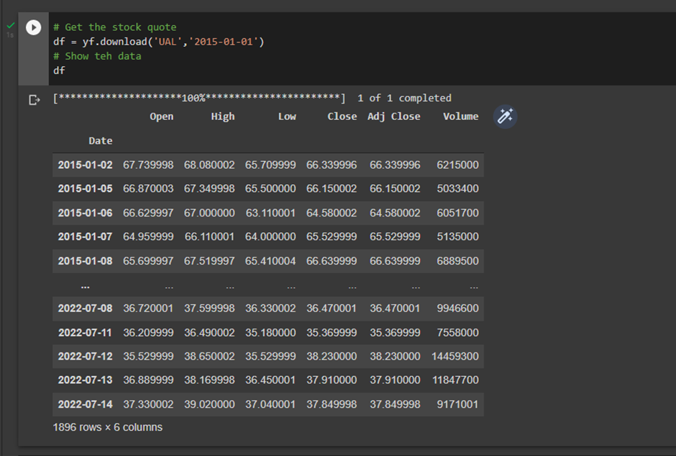
Using the Stock’s History
The model is trained based on the previous market performance of the stock. We first download the data of the closing prices of the stock.
We can choose the date from which we want to consider data.

Slide 14
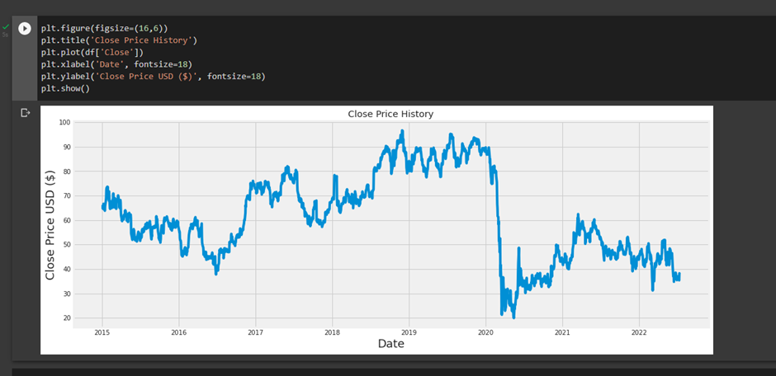

Slide 15
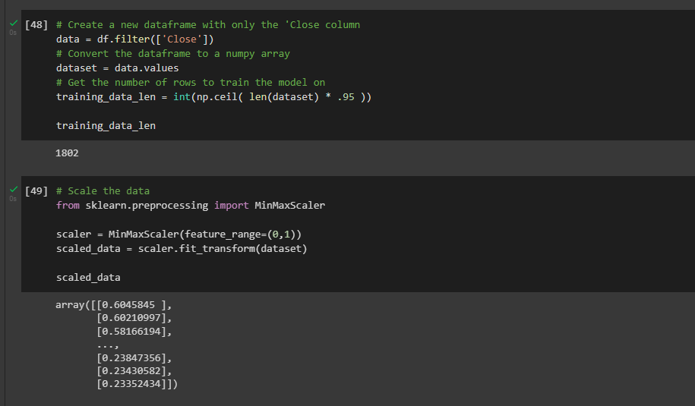
Scaling the Data
The data set considers many values like Open, High, Low, Close, Volume. The first code makes it so that it only considers the closing price for training.
The model is trained using 95% of the data and the remaining will be used for testing.
The second code scales all the closing prices to be between 0 and 1 so that the program deals with smaller values.

Slide 16
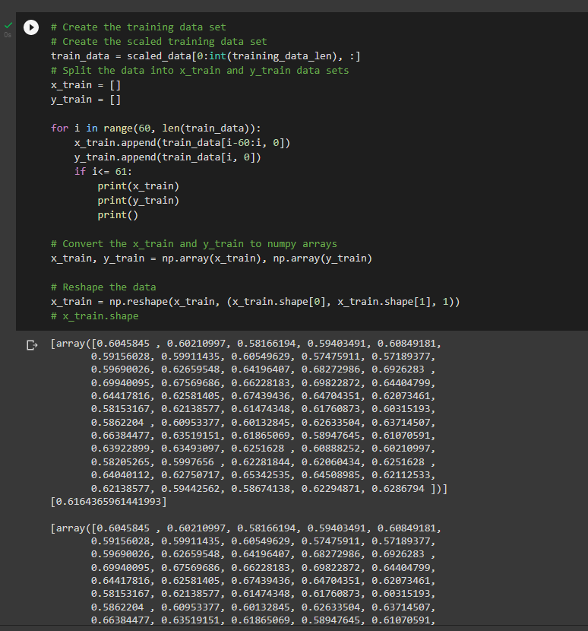
Training the Data
This code trains the model based on the scaled data, making the program more efficient.
The x_train and y_train data are stored as a np array, which allows for fast operations on arrays, including mathematical, logical, shape manipulation, sorting, selecting, I/O, discrete Fourier transforms, basic linear algebra, basic statistical operations, random simulation and much more.

Slide 17
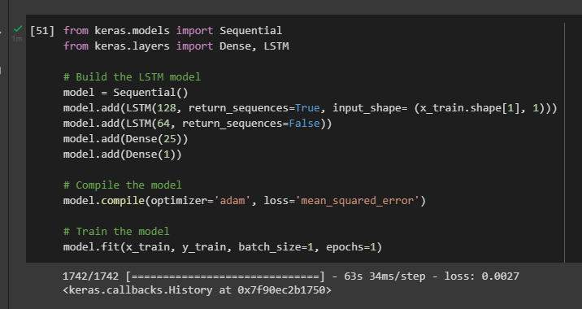
Building the LSTM Model
LSTM takes inputs from prior data and minimizes the difference between the predicted value and measured value.
We add desne layers for training
We optimise the model and measure the loss as a mean squared error.
Finally wet train the model

Slide 18
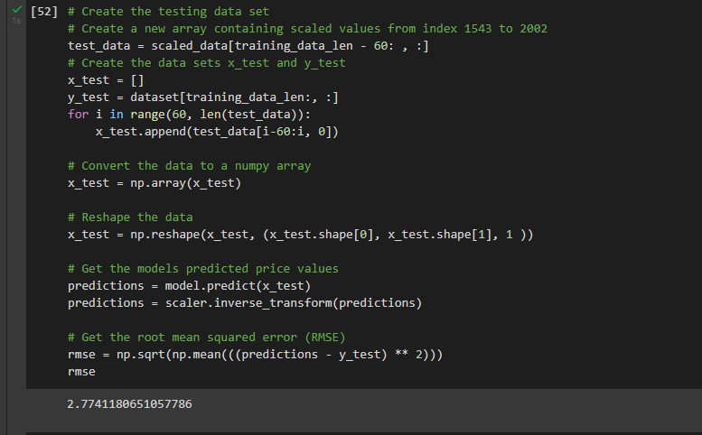
Testing
The data that was not used for training is now used for testing.
The testing data is converted to a np array so that we can work with it more easily (shaping, plotting etc)
The mean square error is then calculated, after comparing the predicted data with the testing data.

Slide 19
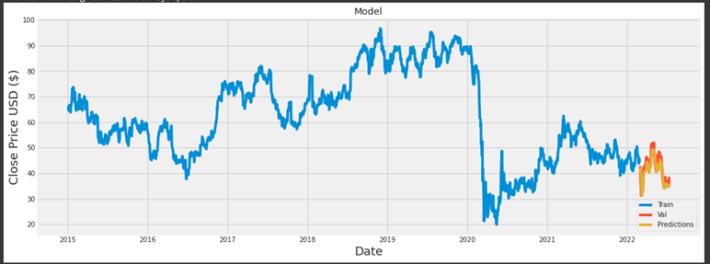
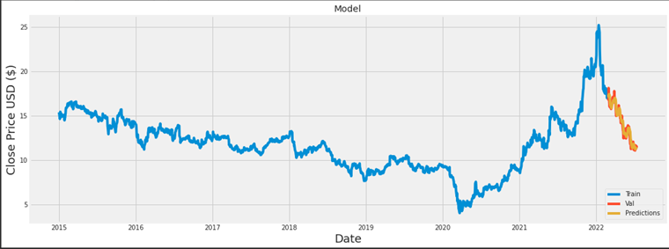
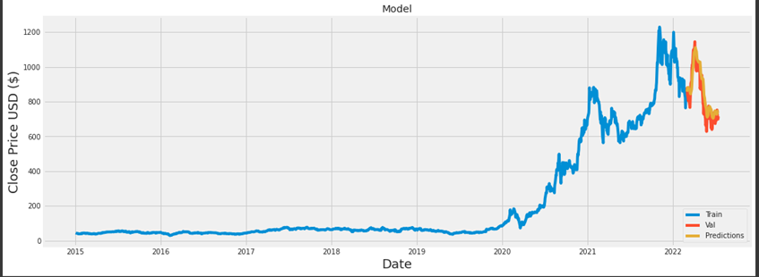
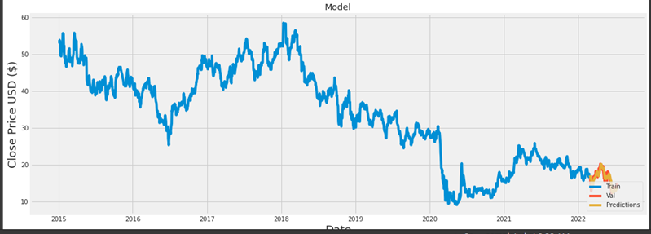
United Airlines
Ford
Tesla
American Airlines
Notes:
Definition. In machine learning, model validation is referred to as the process where a trained model is evaluated with a testing data set. The testing data set is a separate portion of the same data set from which the training set is derived.

Slide 20
Comparisons:
The Mean Squared Errors are: United - 2.77
Ford - 0.534
Tesla - 66.218
The model appears to be inaccurate with Tesla, however that is because the stock price of Tesla is much higher on an average and varies with a greater magnitude.
We ran the model again with 1 less dense layer, and we decrease the number of parameters considered by the LSTM and dense layer.
Result - 91.22 which is 38% worse.
We also experimented with relu activation, but it worsened the performance of the model

